Slide 1

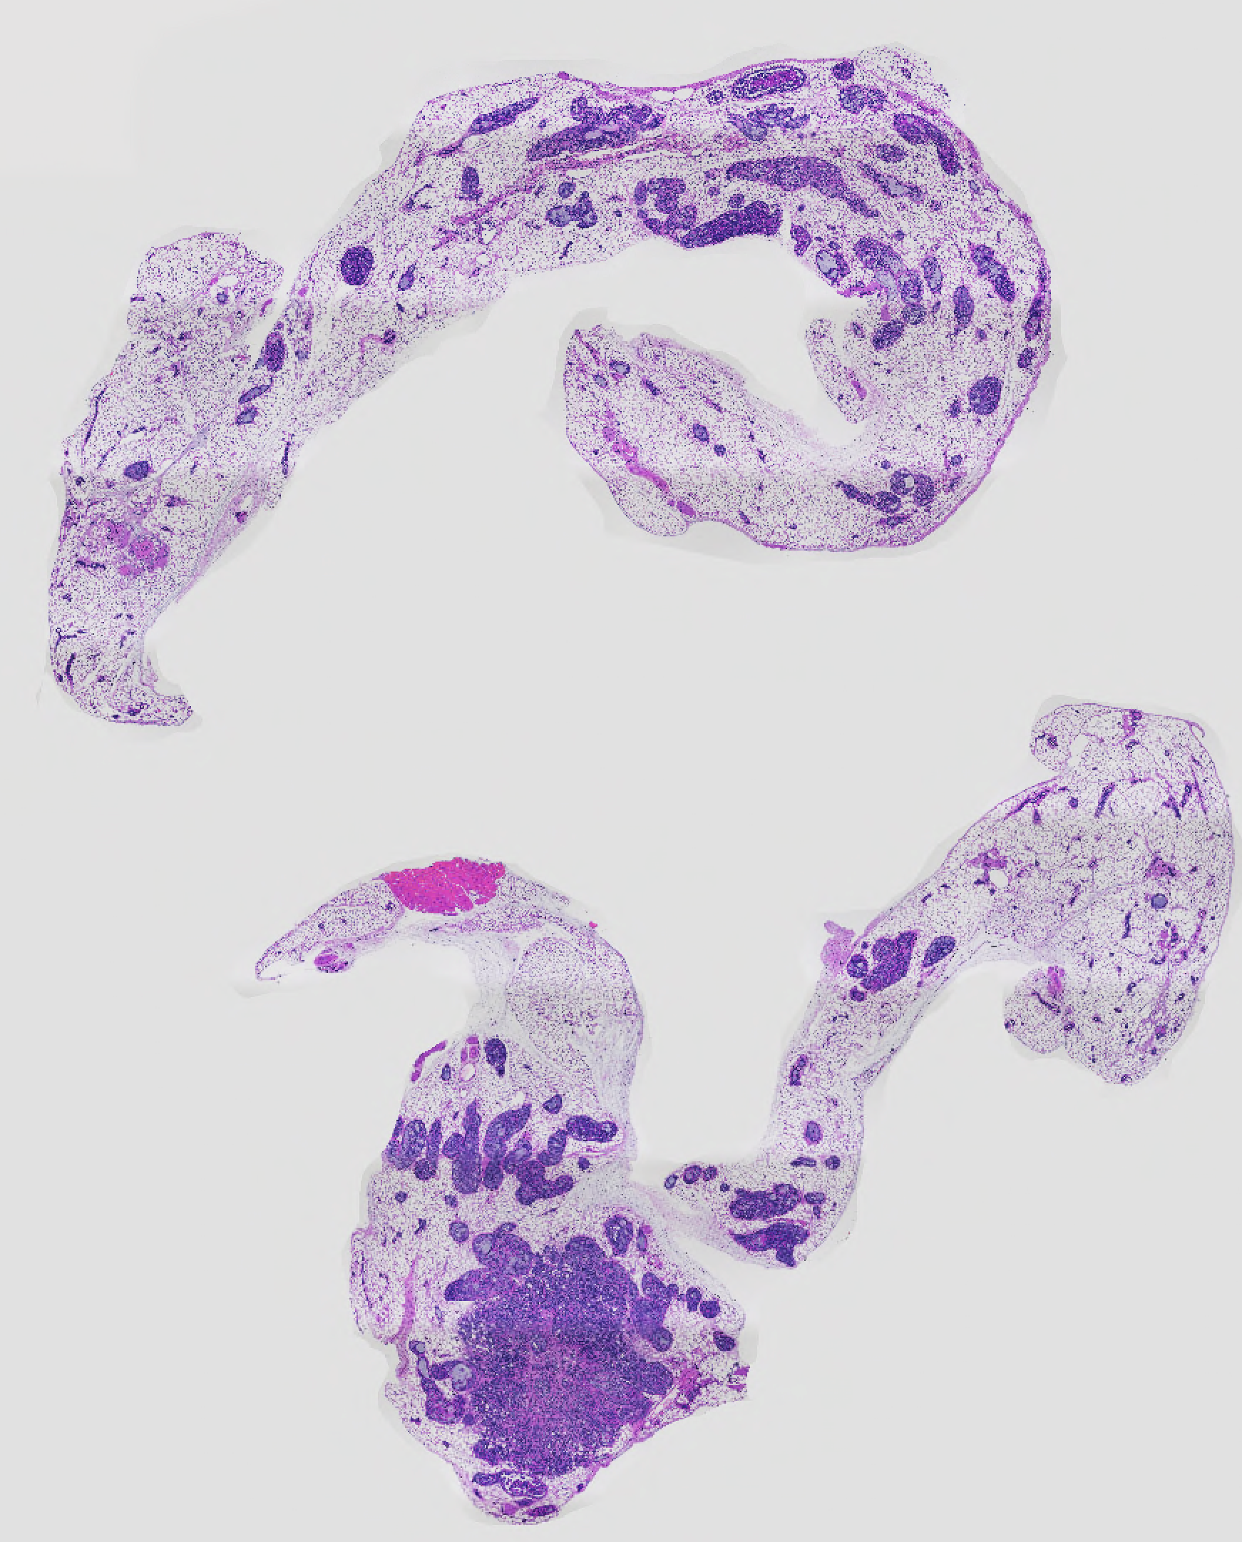
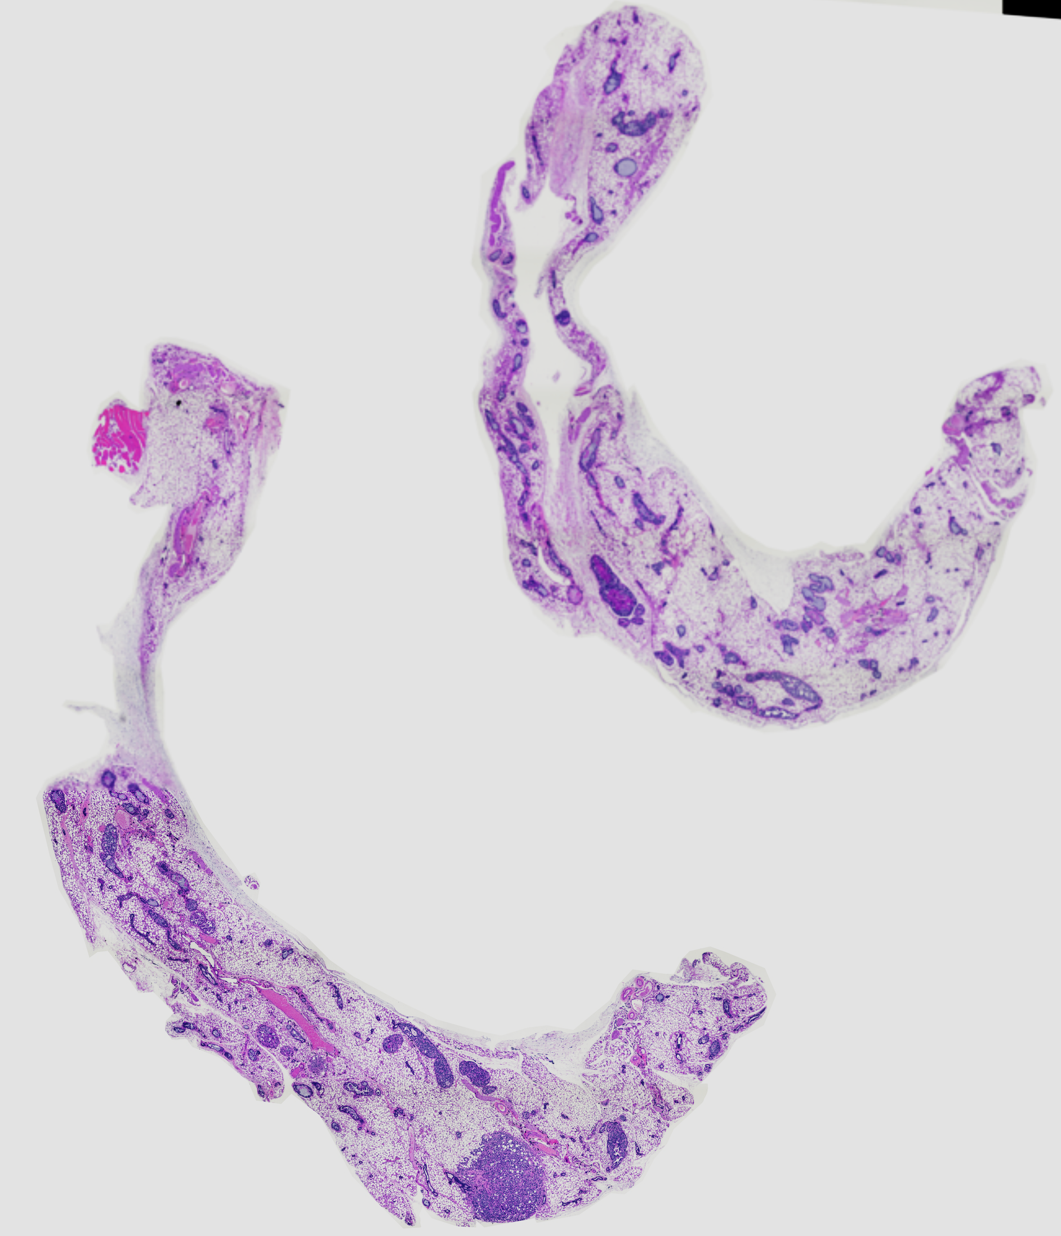
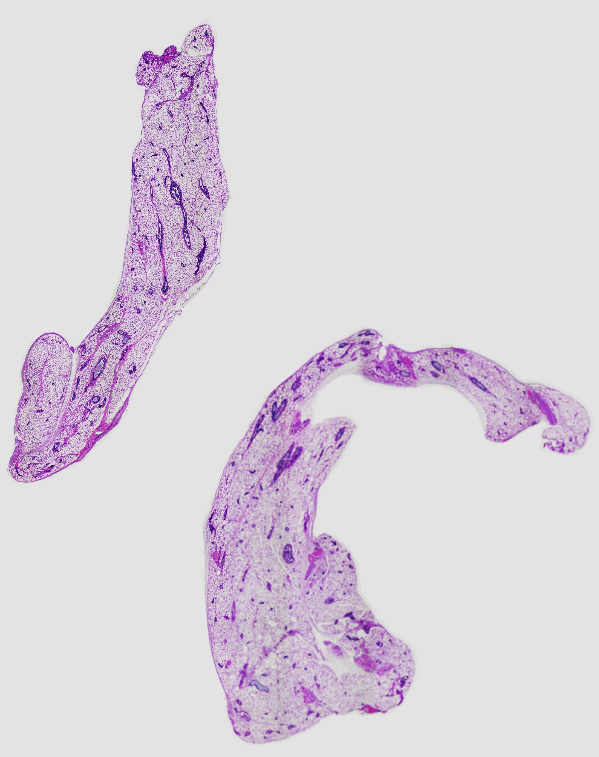
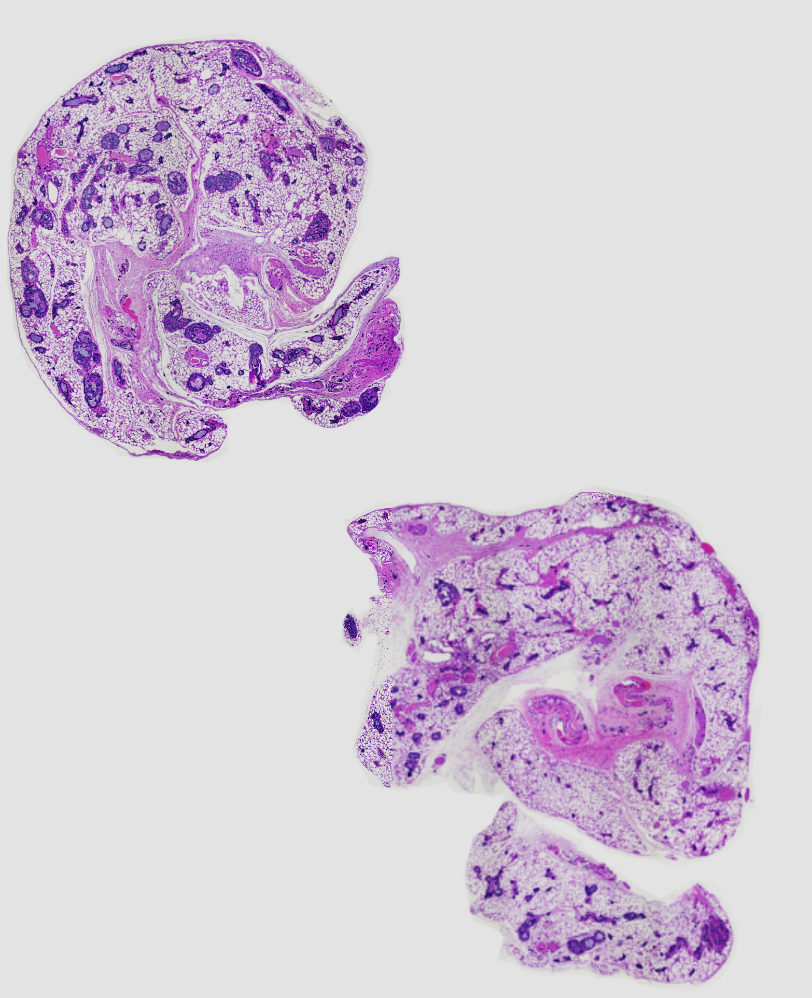
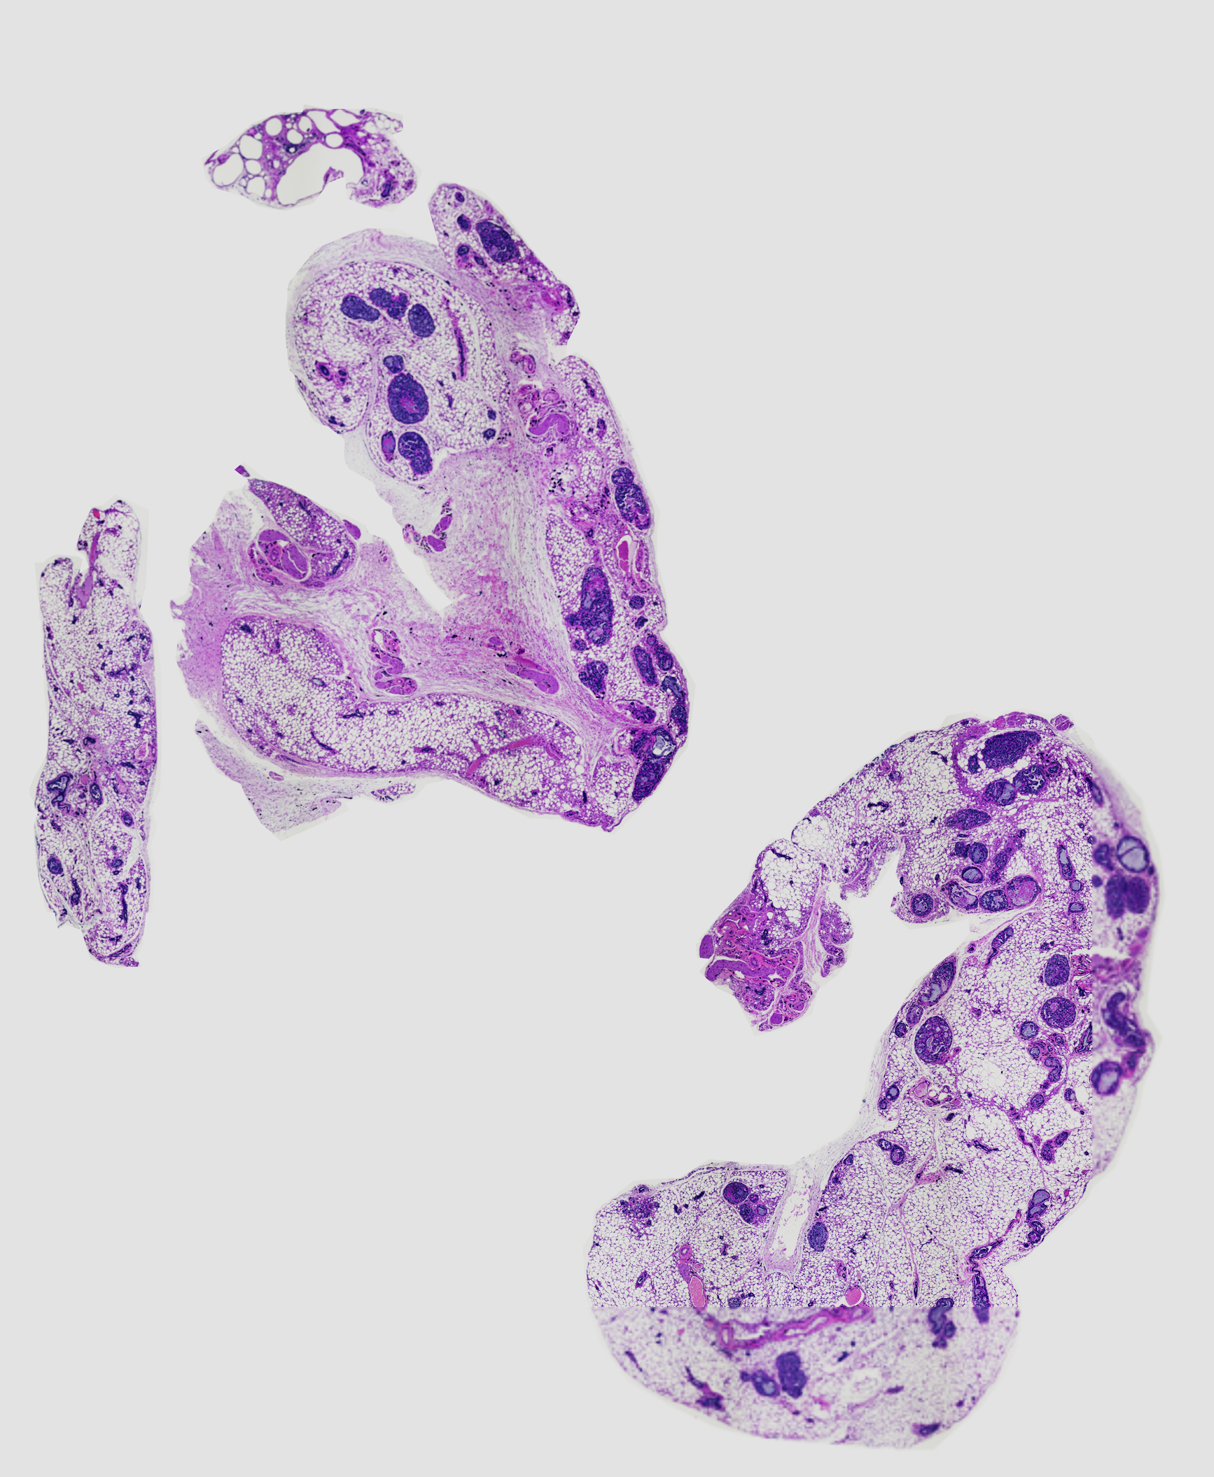
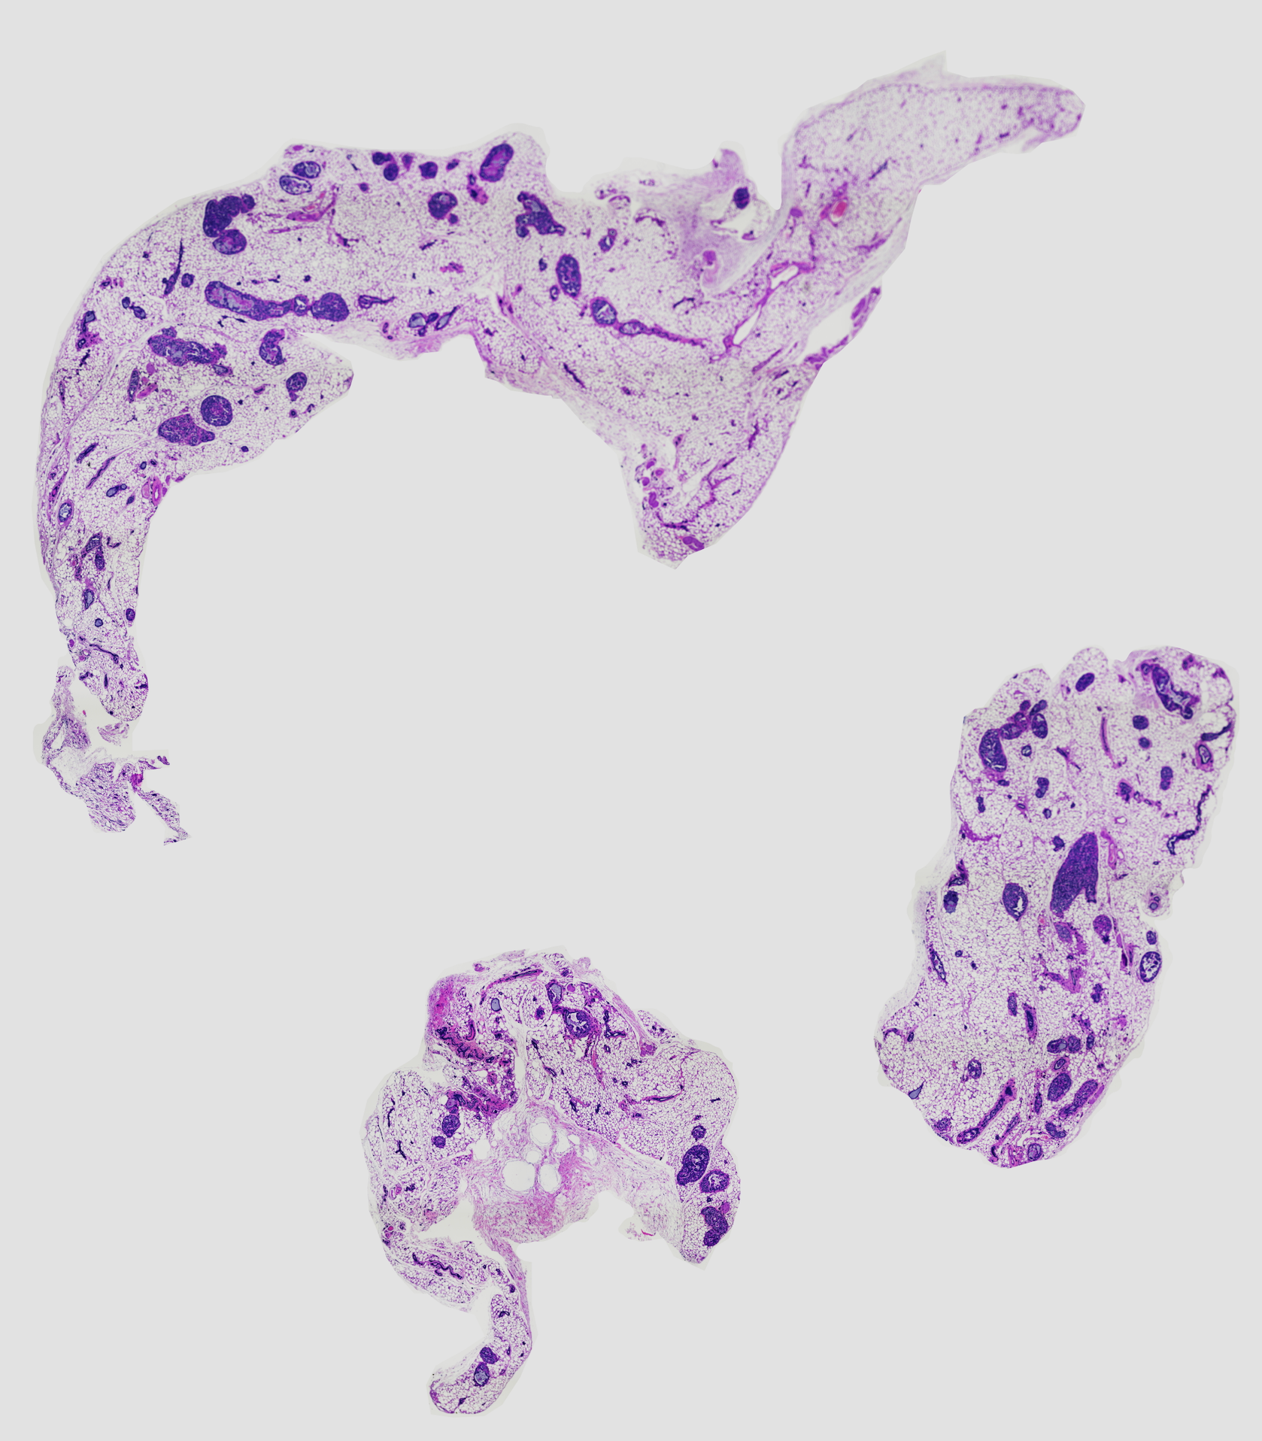
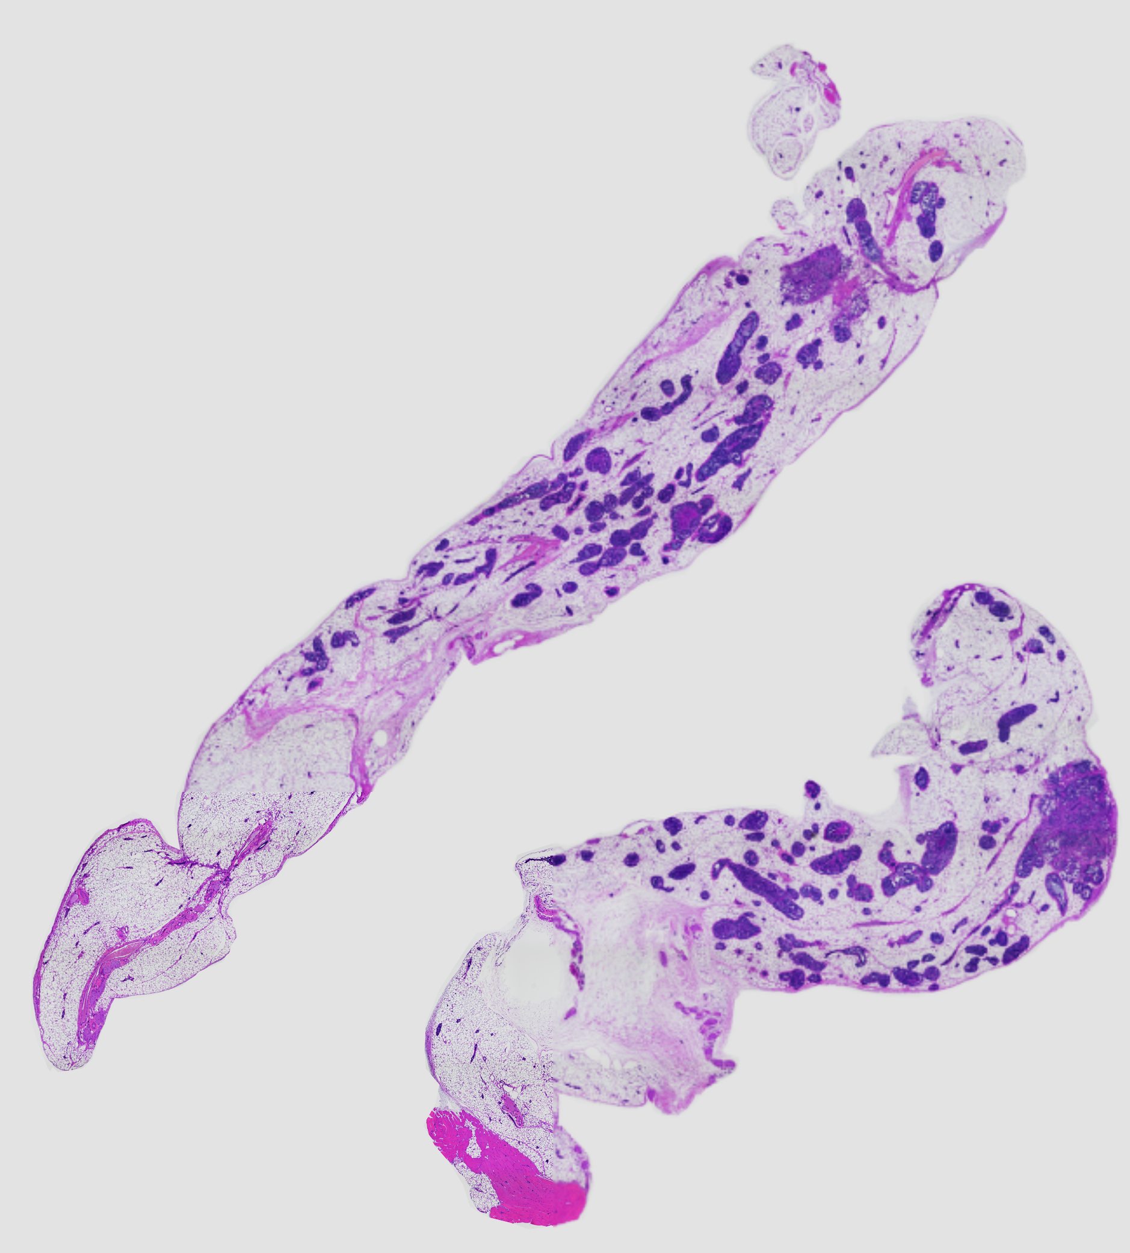
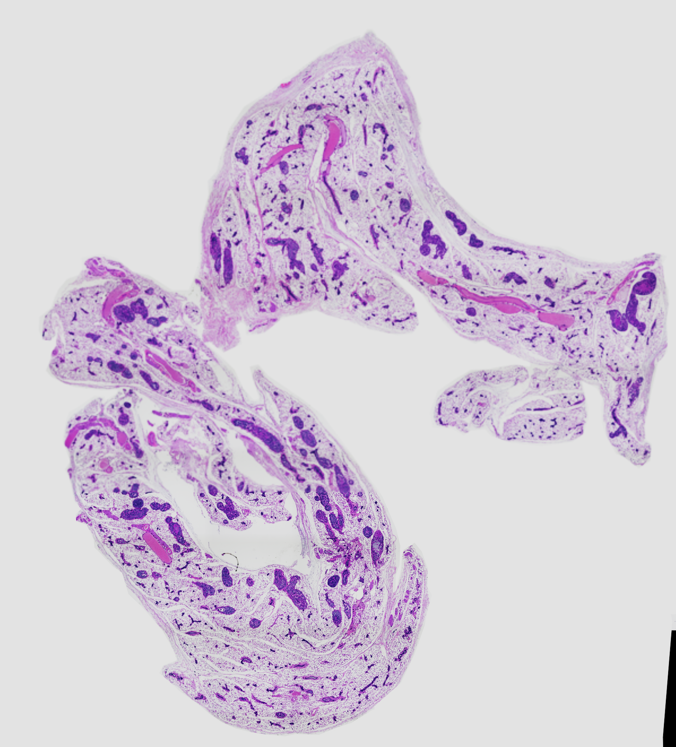
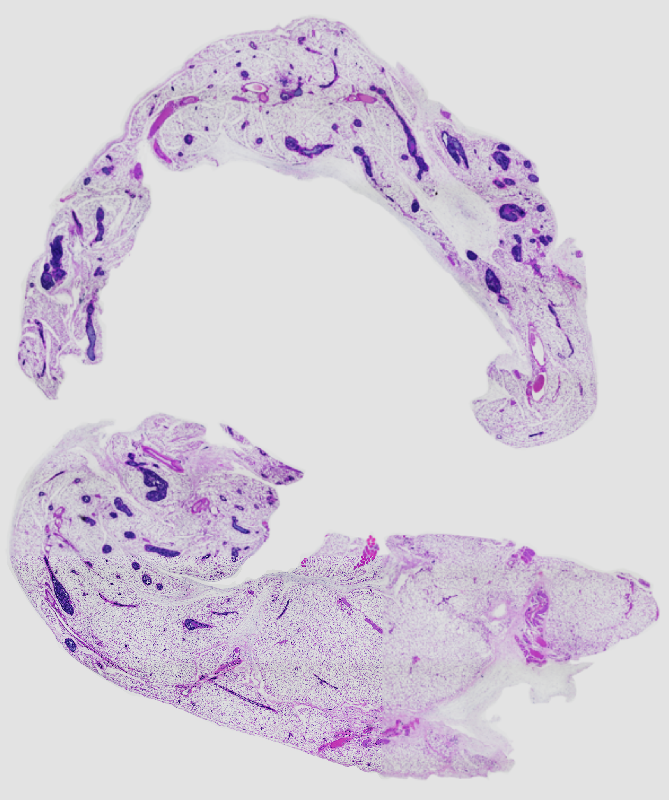
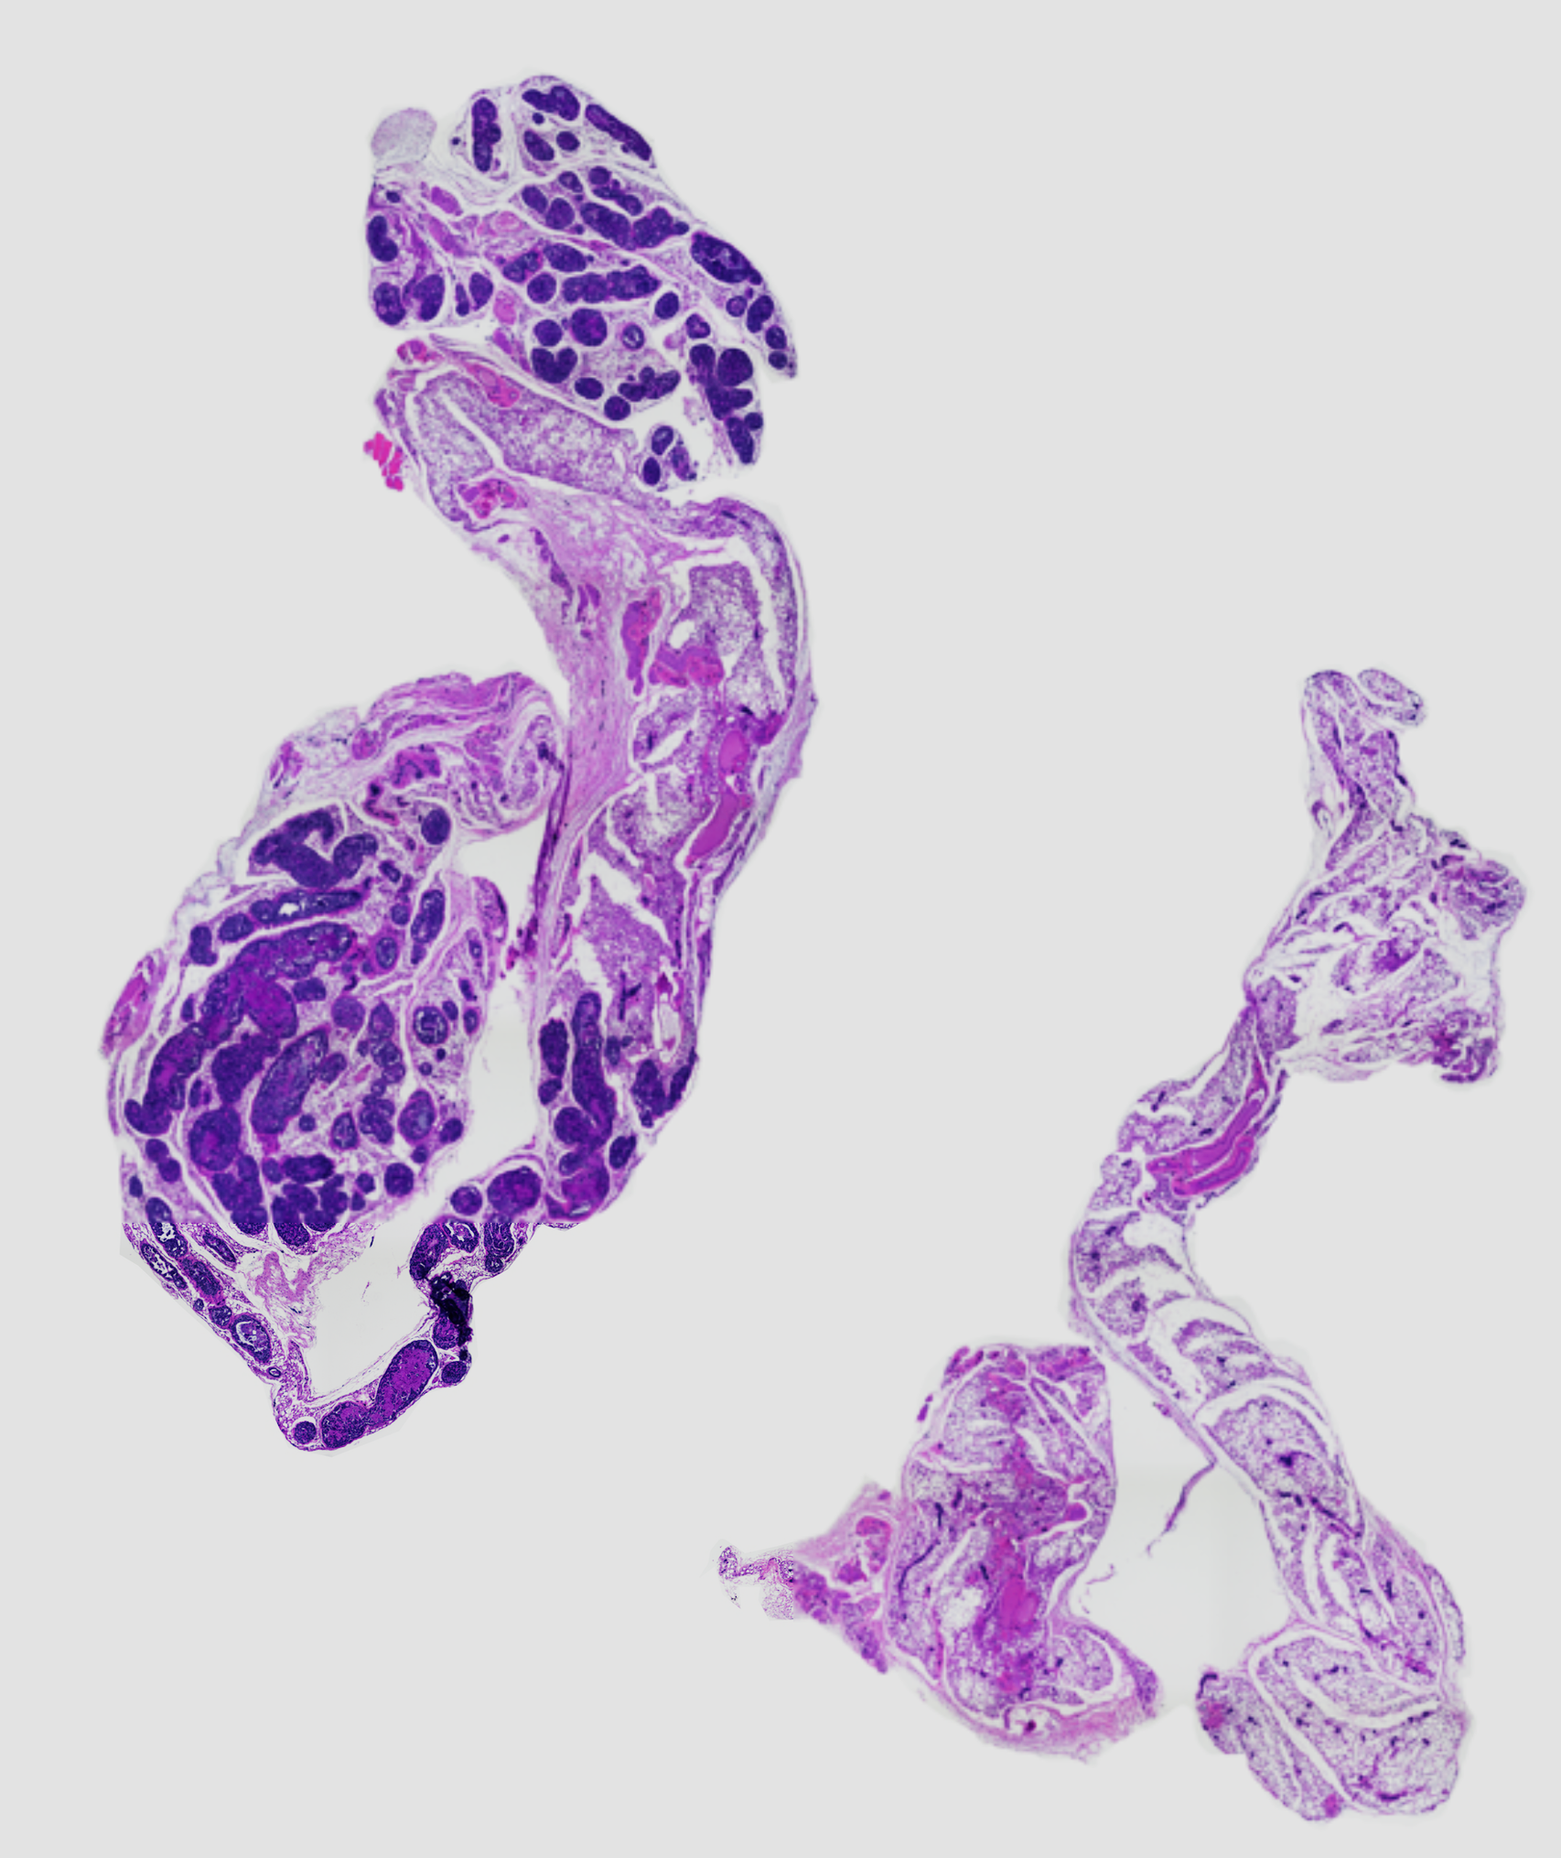
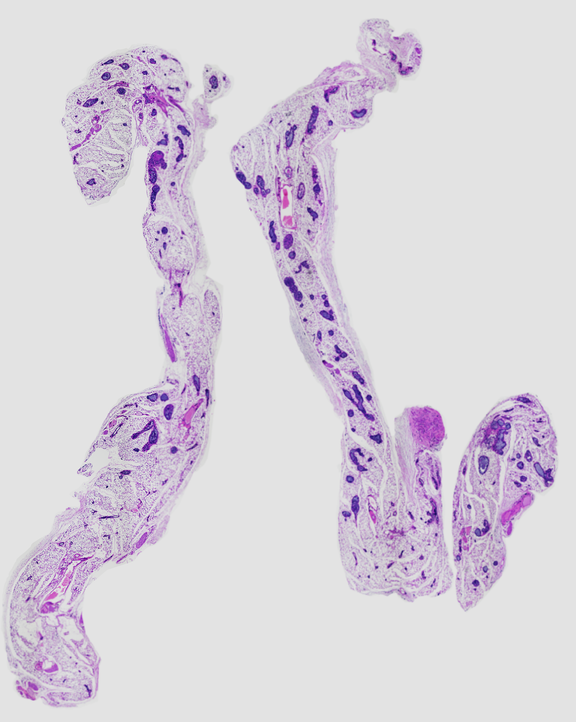
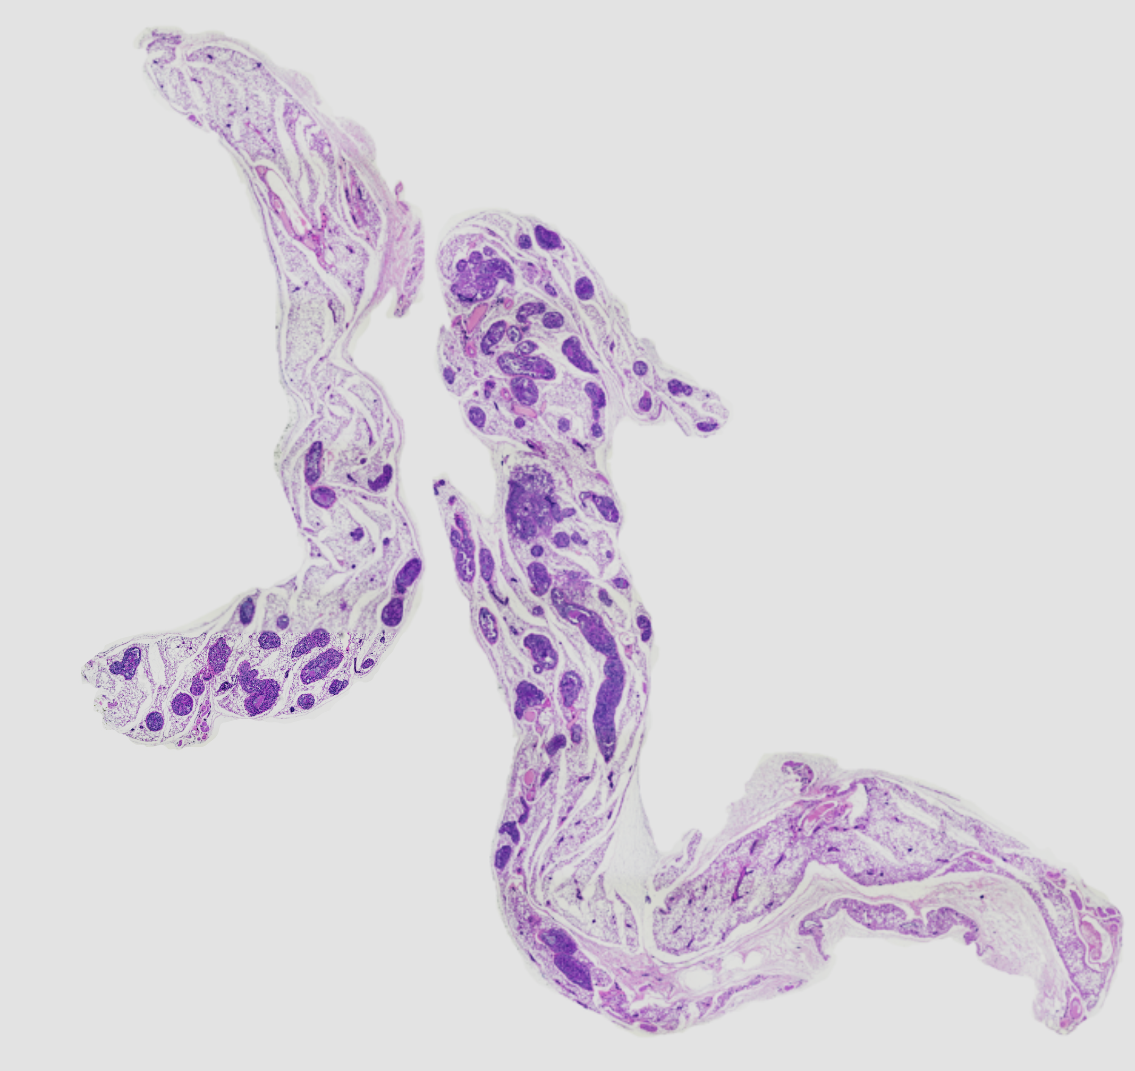
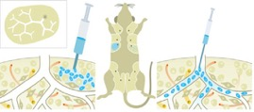
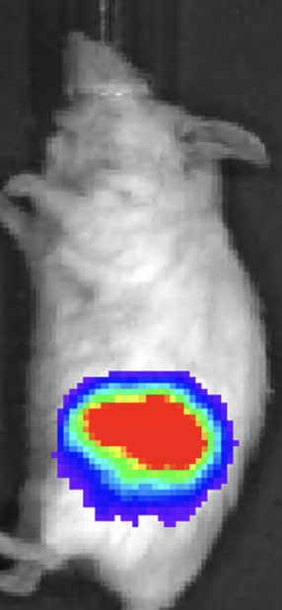
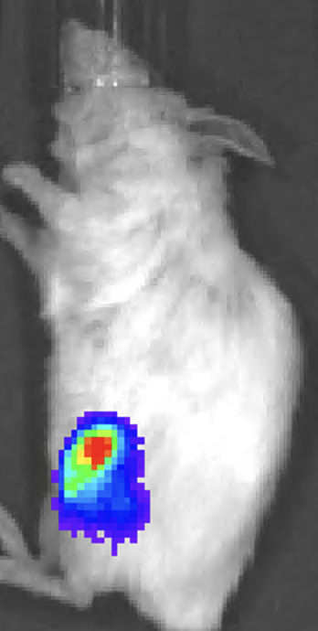
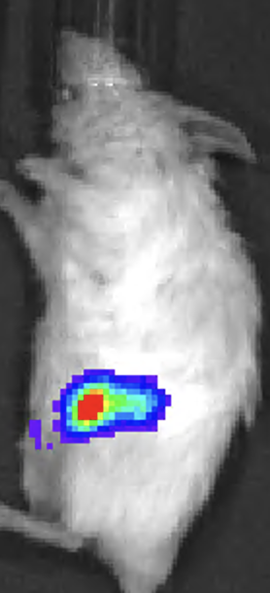
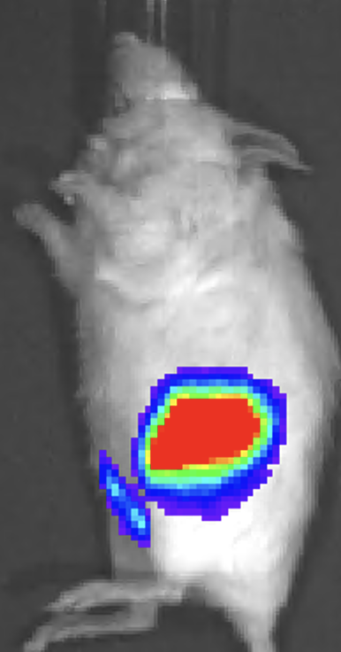
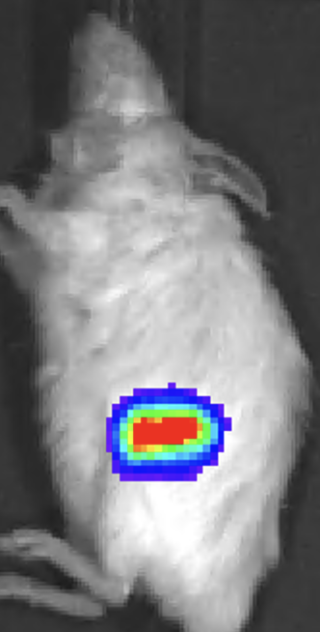
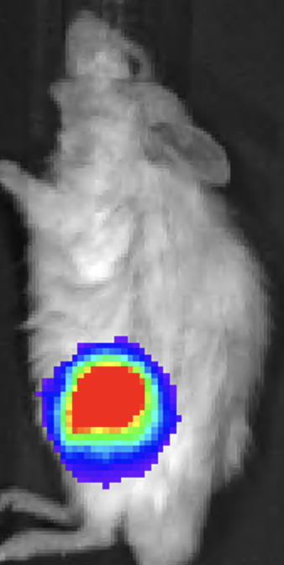
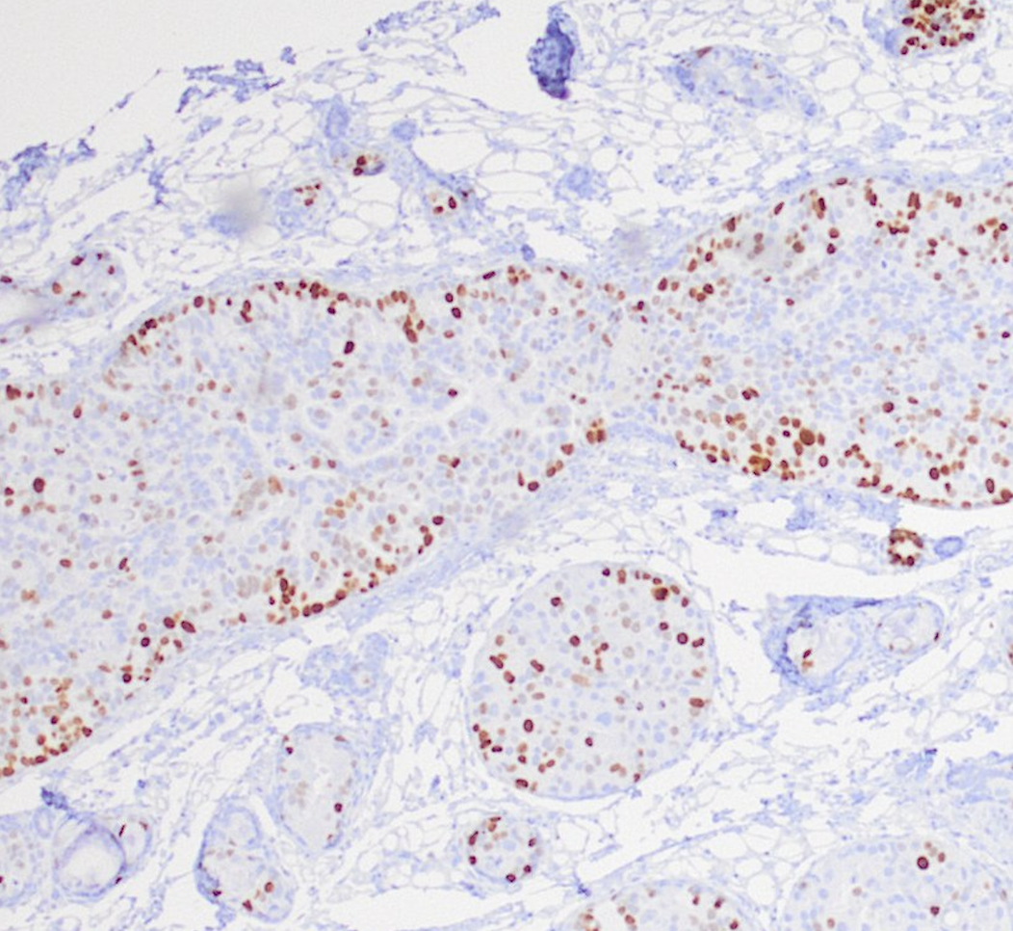
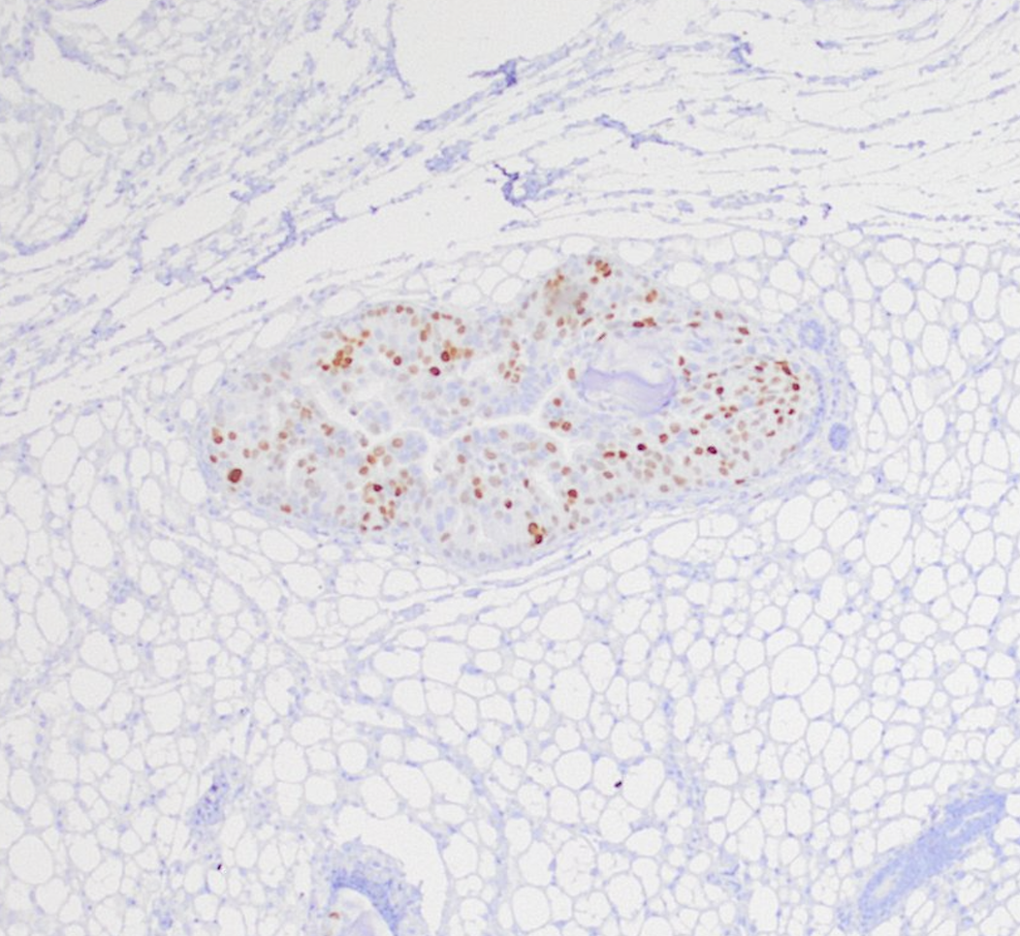
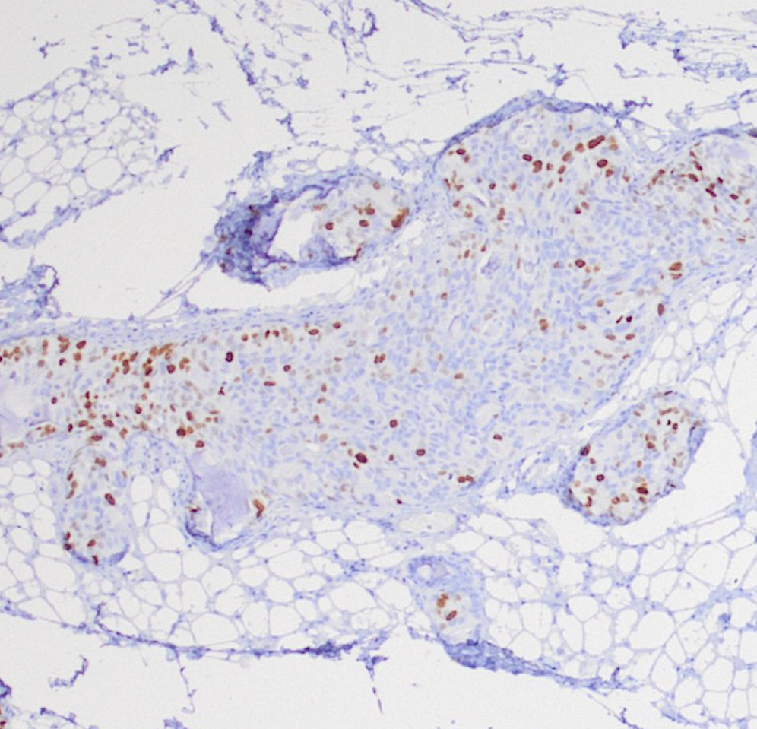
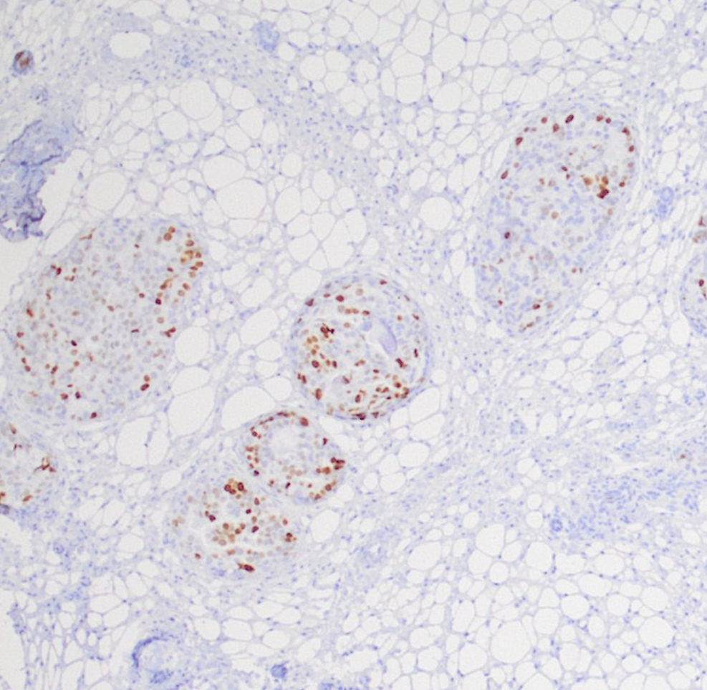
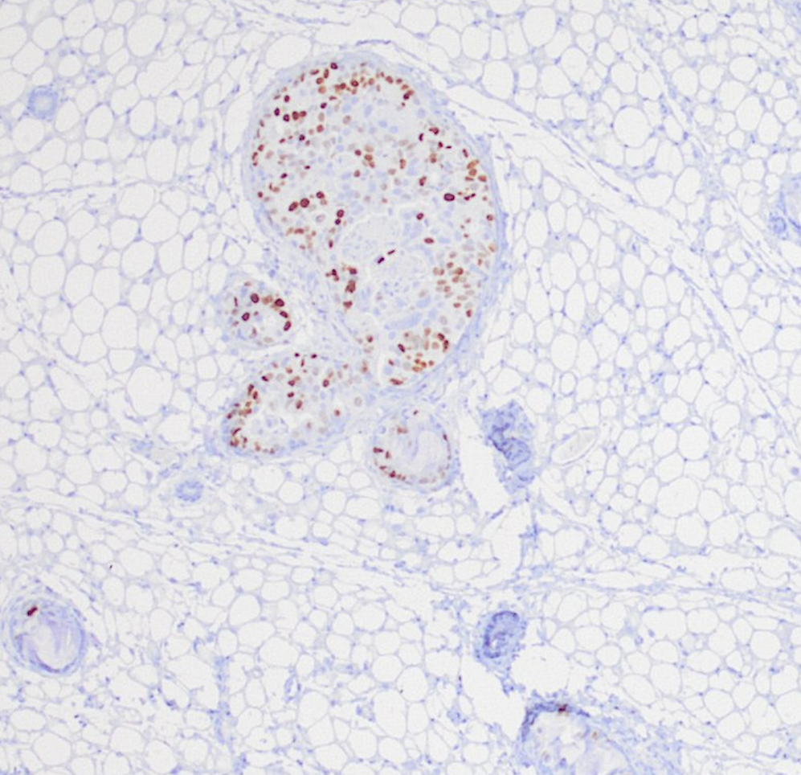
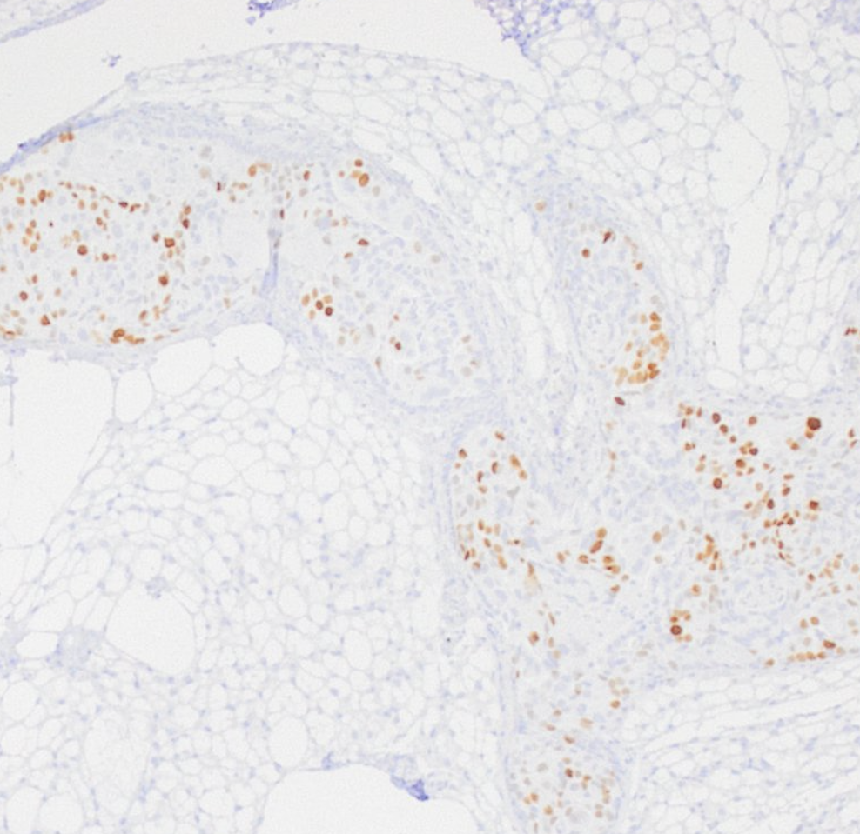
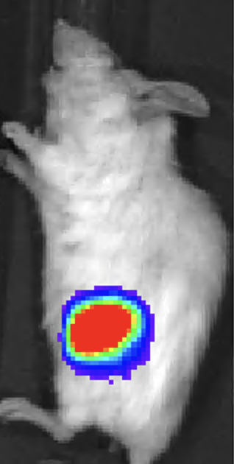
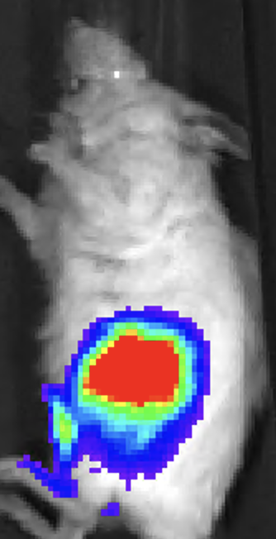
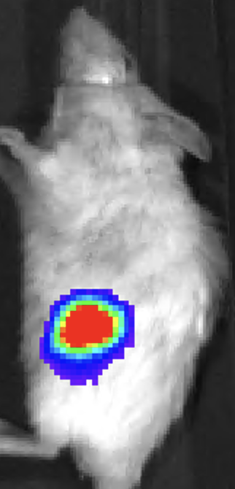
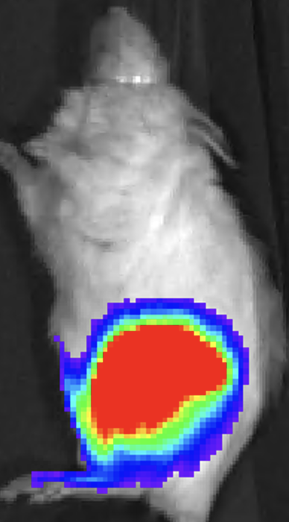
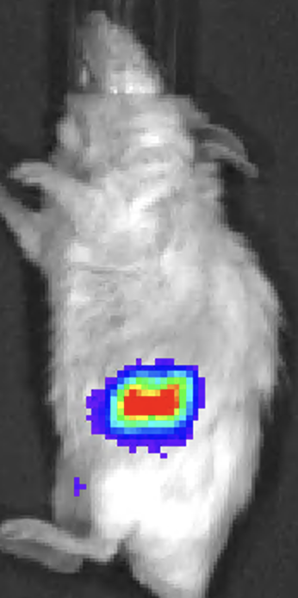
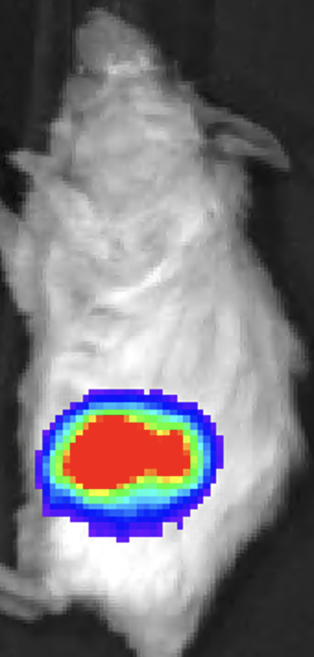
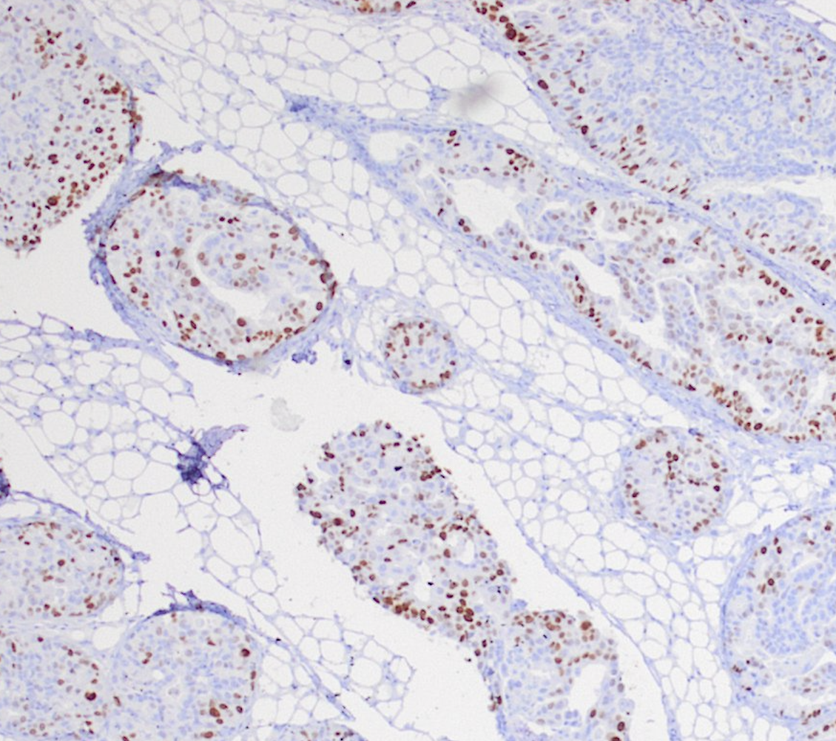
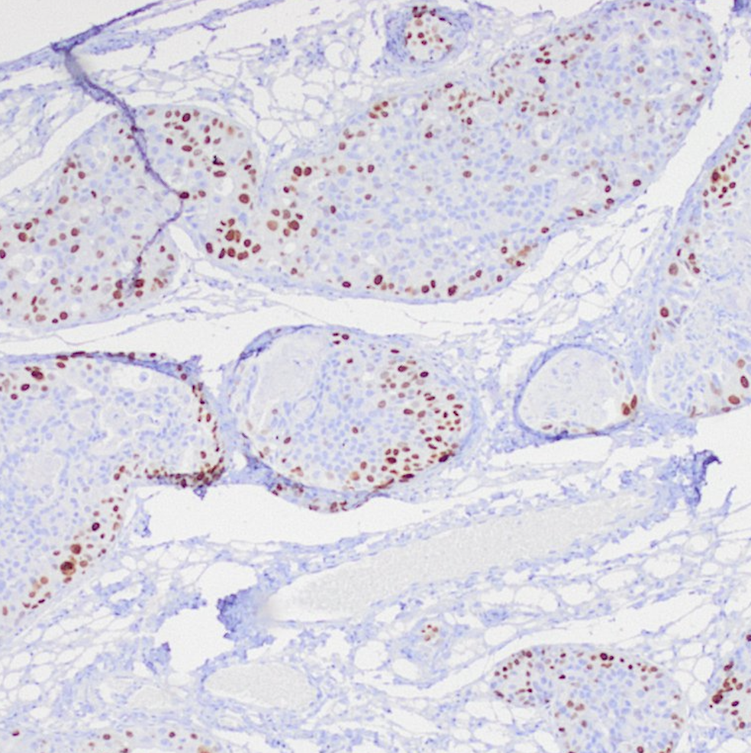
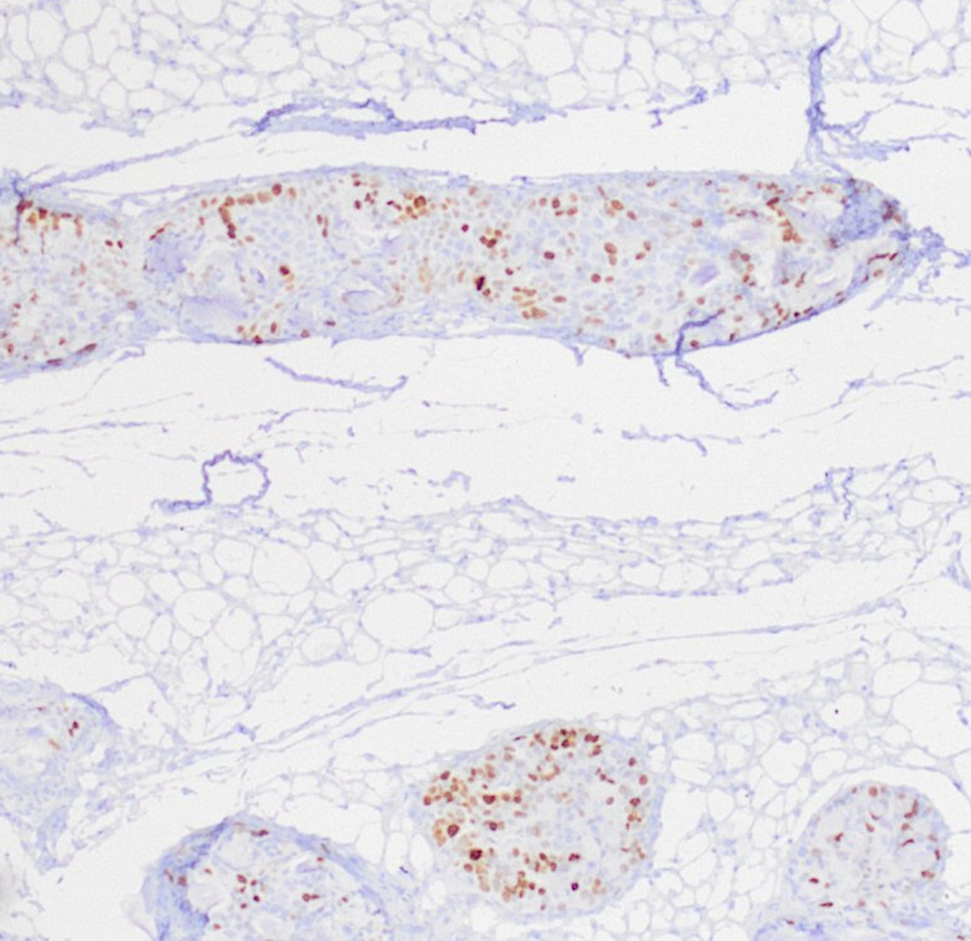
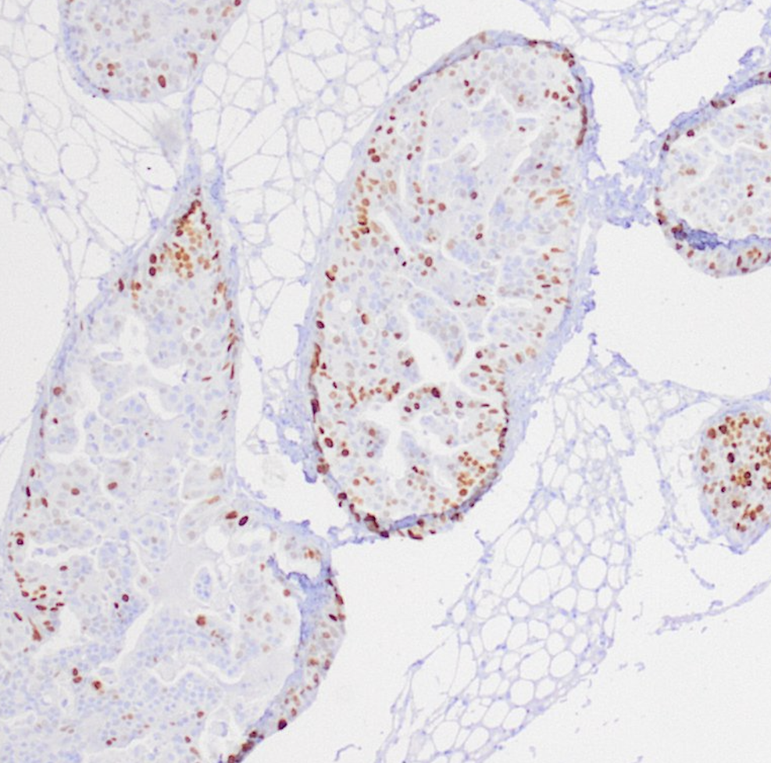
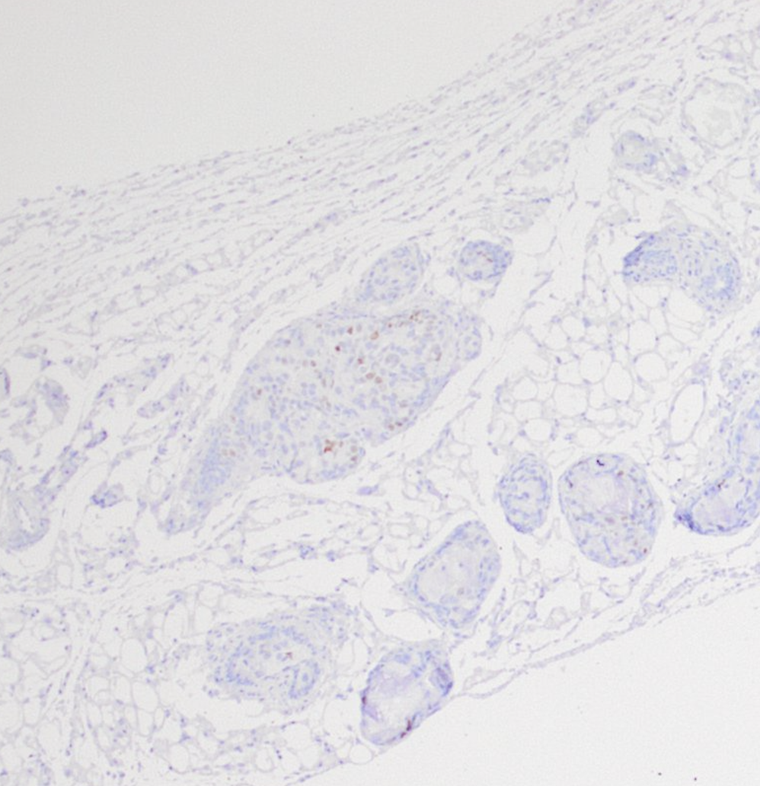
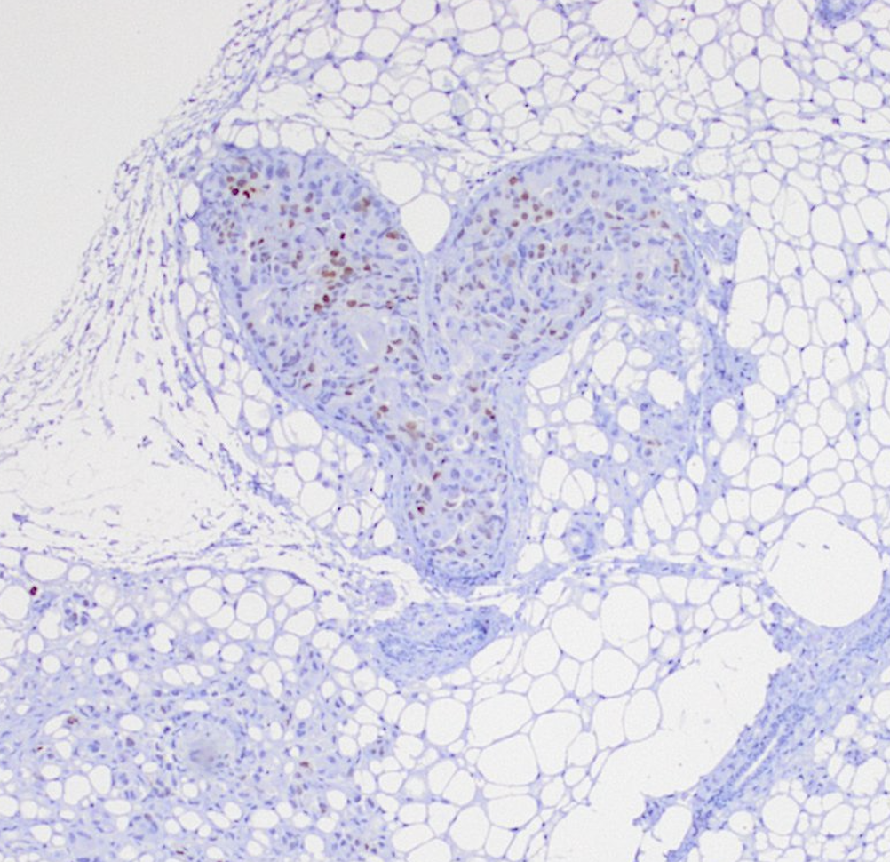
Lasofoxifene as a Potential Treatment for Aromatase Inhibitor Resistant ER+ Breast Cancer
Muriel Lainé ¹, Marianne Greene ¹, Tiffany Leng ¹, Justyna Kurleto ¹, Sophia Li ¹, Barry Komm ² and Geoffrey L. Greene ¹
¹ Ben May department, University of Chicago, Chicago Il
² Sermonix Pharmaceuticals
Introduction
In postmenopausal women breast cancer is typically treated with endocrine therapy or estrogen depravation, which is achieved with aromatase inhibitors (AI) such as letrozole. The AI approach have been shown to be superior to tamoxifen treatment but in 20% of cases, patients are resistant to AI treatment or undergo relapse. Women that are resistant to AI therapy are treated with fulvestrant or a combination of fulvestrant and a CDK4/6 inhibitor as a second line of therapy. We have previously demonstrated in a xenograph model of ET resistant mutant ER+ metastatic breast cancer (MBC) that lasofoxifene alone and in combination with palbociclib was superior to fulvestrant or a combination of fulvestrant+palbociclib. In the current study, we compared the efficacy of lasofoxifene +/- palbociclib to fulvestrant +/- palbociclib combinations in a letrozole-induced, AI-resistant breast tumor model (MCF-7 LTLT cells) that does not express ERα activating mutations.
Lasofoxifene + palbociclib combination significantly reduces tumor burden compared to palbociclib + fulvestrant
Lasofoxifene + palbociclib combination reduces bone metastasis
A
Veh
Palbo
Laso
Fulvestrant
Laso+Palbo
Ful+Palbo
A
B
Letrozole
Let+Palbo
Let+Laso
Let+Ful
Let+Laso
+Palbo
Let+Ful
+Palbo
Results
B
C
Lasofoxifene alone and in combination with palbociclib significantly slows primary tumor progression
A
B
Fig 4: A&B, Box plot representing average radiance of bones measured ex-vivo in a Xenogen IVIS imager. P values are calculated by one way Anova *p<0.05, N=6-12 bones
Experimental design
C
Fig 2: A, H&E staining of representative mammary glands for each treatment group. B & C, Box plot quantification as percent tumor area based on H&E staining analyzed with NSI element software. P values are calculated by one way Anova *p<0.05, **p<0.001. N=3-6 mice
End Point Ex vivo imaging
Veh
Palbo
Laso
Fulvestrant
Laso+Palbo
Ful+Palbo
11 weeks
IVIS imaging every week
MIND injection 2 sides Day 0
Intraductal injection of ~250,000 cells in glands 4 and 9.
Lasofoxifene + palbociclib combination reduces tumor cell proliferation
Start treatment day 27
Treatments:
Veh 5 days/week sc
Laso 10 mg/kg, 5 times/week sc
Palbo 70 mg/kg
Fulvestrant 5mg/mouse (~250 mg/kg) 1/week sc
Laso + Palbo
Palbo + fulvestrant
Treatments:
Letrozole 1 μg 5 days/week sc
Let + Laso 10 mg/kg, 5 times/week sc
Let + Palbo 70 mg/kg
Let + Fulvestrant 5mg/mouse (~250 mg/kg) 1/week sc
Let + Laso + Palbo
Let + Palbo + fulvestrant
Let+Laso
+Palbo
Let+Ful
+Palbo
A
Veh
Palbo
Laso
Fulvestrant
Laso+Palbo
Ful+Palbo
Letrozole
Let+Palbo
Let+Laso
Let+Ful
Letrozole
Let+Palbo
Let+Laso
Let+Ful
Let+Laso
+Palbo
Let+Ful
+Palbo
B
C
Conclusions
Lasofoxifene alone or in combination with palbociclib inhibits primary tumor growth in a model of AI resistant breast cancer.
The combination of lasofoxifene with palbociclib reduces tumor cell proliferation.
Lasofoxifene + palbociclib decreases metastasis to the bone.
Lasofoxifene +/- Palbociclib is a promising therapy for AI resistant breast cancer.
D
E
Fig 1: A & B, Quantification of total photon flux measure over time in Xenogen IVIS imager. C, representative images at 11 weeks after start of treatment. D & E, Histograms of total photon flux for each group at the study end point. P values are calculated by one way Anova *p<0.05, **p<0.001, ***p<0.001, ****p<0.0001. N=3 to 6
Fig 3: A, IHC staining of mammary glands with Ki67 antibody showing overall lower percentage of proliferation in the letrozole+laso+palbo group. B & C, Box plot representing the quantification of the Ki67 percent. Insert box plot comparing veh to letrozole treatment group. P values are calculated by one way Anova *p<0.05, **p<0.001, N=3 to 6 mice
Acknowledgments
MCF7 LTLT were kindly provided by Dr Tekmal San Antonio TX.
Histology was performed by the Human Tissue Resource Center at university of Chicago
Imaging was performed at the small imaging facility at the University of Chicago
Mouse housing and treatment was performed at the Animal Resource Center at the University of Chicago

